Slide 1


Distracted Driver Behavior Classification
Elmer Atienza, Yining Feng, Narmada Gomatam
The AI Consulting Group
Notes:
Hello and welcome everyone! Yining Feng, Elmer Atienza and I Narmada Gomatam teamed up to analyze Distracted Driver Behavior Classification. We look forward to sharing our journey in this project with you.

Slide 2

What is distracted driving?
Distracted driving is any activity that could divert attention from the primary task of driving.
Notes:
Distracted driving is any activity that diverts attention from driving. According to the CDC motor vehicle safety division, one in five car accidents is caused by a distracted driver. Sadly, this translates to 425,000 people injured and 3,000 people killed by distracted driving every year.
As you can see from the video, this includes talking or texting on your phone, eating and drinking, talking to people in the vehicle, fiddling with the stereo, entertainment or navigation system — anything that takes one’s attention away from the task of safe driving.

Slide 3
Problem Statement
Develop a computer vision model that distinguishes distracted driving behaviors from safe driving posture
Business Applications:
Facilitate faster claims processing and assessing the liability of claims
Minimize insurance disputes with more accurate damage inspection
Usage-Based Auto Insurance (UBI)
Inference-based Driving Risk Prediction
Notes:
The Distracted Driving Behavior Classification Model intends to provide inferences for distracted driving behaviors using thousands of images of individuals driving inside a vehicle. This could be beneficial for many business applications in the auto industry for promoting safe driving behaviors such as Driver Behavior Detection for facilitating faster claims processing, Incentive to reduce insurance rate based on existing driving records etc.The image classification model can also be incorporated into a smartphone app to help raise drivers’ awareness of their driving habits and associated risks, thus helping to reduce careless driving and promoting safe driving practices to reduce the accident rate. We will briefly discuss image classification in our next slide.

Slide 4
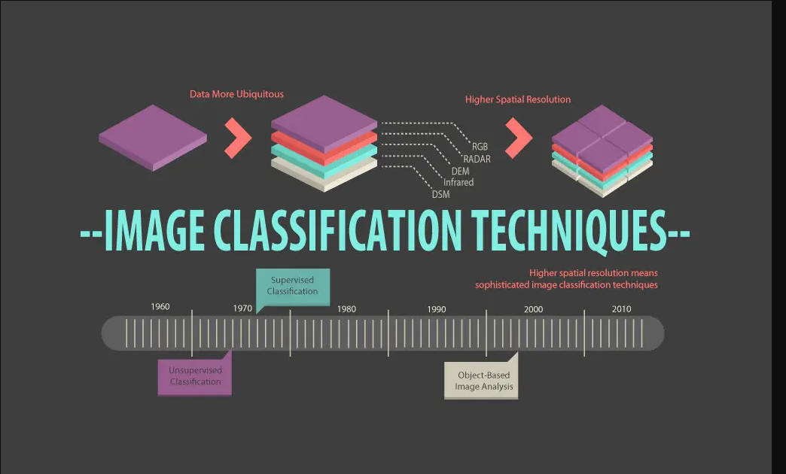
Image Classification
Notes:
Image classification refers to a process in computer vision that can classify an image according to its visual content. Designing a suitable image‐processing procedure is a prerequisite for a successful classification of distracted driving behavior images. The major steps of image classification may include determination of a suitable classification system, selection of training samples, image preprocessing, feature extraction, selection of suitable classification approaches, post‐classification processing, and accuracy assessment.

Slide 5
Image classification models
Modeling techniques:
Convolutional Neural Network (CNN)
Transfer Learning Models
VGG-16
ResNet
Xception
MobileNet
K-NN ensemble
AutoML
Notes:
In this study, we proposed and studied 6 models in total, including a CNN model trained from scratch i.e. a traditional classification model with hand-crafted features which was our baseline CNN and four transfer learning models built with pretrained CNN models: ResNet50, VGG-16, Xception, MobileNet as well as a K-NN ensemble model.
Deep convolutional neural network models may take days or even weeks to train on very large datasets. A way to short-cut this process is to re-use the model weights from pre-trained models that were developed for standard computer vision benchmark datasets, such as the ImageNet image recognition tasks. The basic premise for us to use transfer learning is simple: take a model trained on a large dataset and transfer its knowledge to a smaller dataset.This reduces the time to train and often results in better overall performance. For example: VGG-16 is a convolutional neural network that 16 layers deep. The model loads a set of weights pre-trained on ImageNet. The Residual Network, or ResNet for short, is a model that makes use of the residual module involving shortcut connections.
Next, we also trained our machine learning models in AutoML in GCP and Apple's CreateML. Google Cloud AutoML goes to a whole different level and customizes Google’s battle-tested, high-accuracy deep neural networks for the tagged data. Rather than starting from scratch when training models from the data, Google Cloud AutoML implements automatic deep transfer learning (meaning that it starts from an existing deep neural network trained on other data) and neural architecture search (meaning that it finds the right combination of extra network layers) for language pair translation, natural language classification, and image classification. Create ML lets you quickly build and train Core ML models right on your Mac with no code.
I will now pass it on to Yining and we will discuss the analysis and results of our models.

Slide 6
Baseline CNN & Transfer Learning Models
Baseline CNN A 2-layer CNN neural network with 100 neurons in the hidden layer Hidden Layer: Rectified linear unit (ReLU) Output Layer: Softmax | VGG-16 A 16-layer CNN neural network with 3 × 3 filters used for all convolutional layers Multilayer perceptron (MLP) classifier + 3 fully connected (FC) layers | ResNet50 A 34-layer CNN neural network with mostly 3 × 3 filters used for all convolutional layers A shortcut connection is added to each building block
Xception A 36-layer CNN neural network with 60,000 parameters 4 residual depth-wise separable convolution layers with residual connections | MobileNet A 28-layer CNN neural network with 3 × 3 depthwise convolutional layers Depth wise separable convolutions | K-NN Ensemble Model Combining (averaging) the results of baseline CNN, VGG-16, ResNet, Xception, and MobileNet models
Notes:
The CNN model is devised as a 2-layer neural network with 100 neurons and ReLU used as the activation function for the hidden layer, as well as a softmax activation function used in the output layer.
Both the VGG-16 and ResNet50 models are CNN network models with 3 × 3 filters used for most of the convolutional layers. Likewise, both the Xception and MobileNet models are multilayer CNN neural network with depth-wise separable convolution layers and residual connections. While the VGG-16 model is characterized by its multilayer perceptron (MLP) classifier including three fully-connected (FC) layers, the ResNet50 model is distinguished by its shortcut connection added to each building block which enables easier model training. On the other hand, the Xception model has the most complex architecture with the most number of CNN layers.
Given that the test set is about four times as large as the training set, overfitting can become a potential problem. By averaging the results of all five stand-alone models, K-NN was included into the ensemble model to help smoothen predicted probabilities for each image class.

Slide 7
Baseline CNN & Transfer Learning Models
Baseline CNN Overfitting: training 90% validation 65% Misclassifications between the class ‘talking to passengers’ and other classes | VGG-16 Misclassifications between the class ‘talking on the phone – left’ and ‘hair and makeup’ | ResNet50 Misclassifications between the class ‘texting right’ and ‘hair and makeup’
Xception Misclassifications between the class ‘texting left’ and ‘safe driving’ & between ‘talking on the phone – left’ and ‘texting left’ or ‘hair and makeup’ | MobileNet Misclassifications between the class ‘texting left’ and ‘safe driving’ & between ‘talking on the phone – left’ and ‘hair and makeup’ Request the least amount of training time | K-NN Ensemble Model Mitigate misclassification problems Outperform all the other stand-alone models K-NN helps smoothen predicted probabilities for each class
Notes:
In terms of performance, all the stand-alone models inevitably struggled with classifying the class “talking to passengers” and “texting left” as well as “hair and makeup” classes. This is due to the lack of temporal context in static images. Overall, the CNN model’s classification accuracy was the lowest because of the overfitting problem, and the K-NN Ensemble model outperforms all the other stand-alone models.

Slide 8
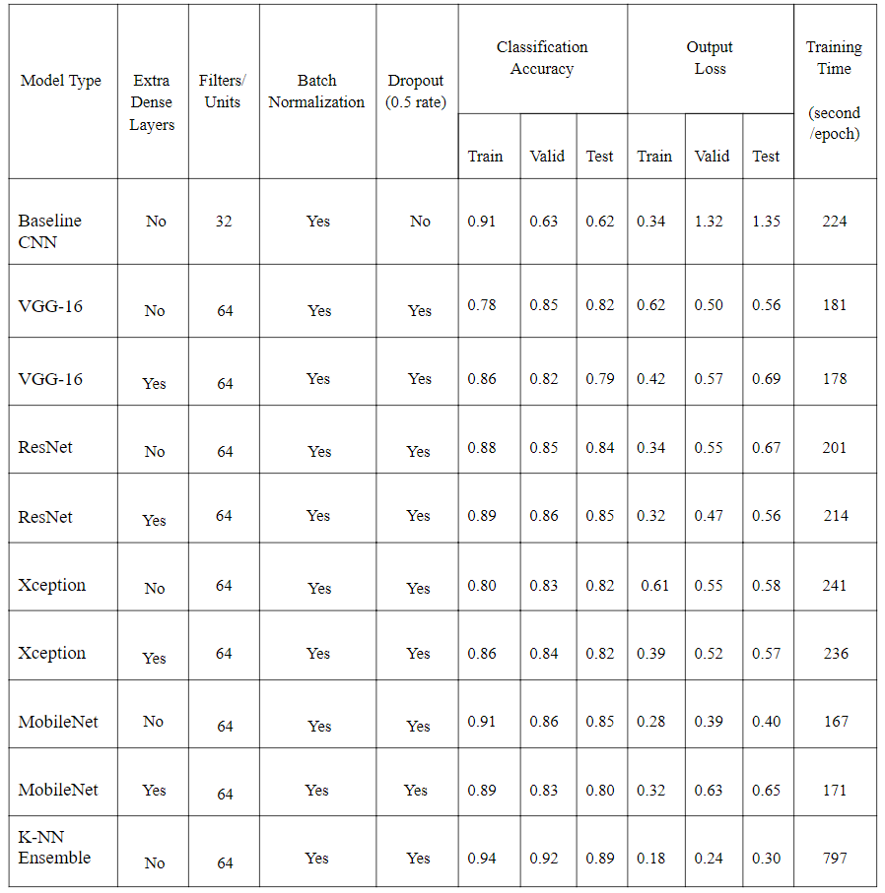
Performance Comparison
K-NN Ensemble Model
The highest classification accuracy (92% validation accuracy) and the lowest output loss (0.24)
MobileNet
The best stand-alone transfer learning model
Requires the least amount of training time (167 seconds per epoch)
86% validation accuracy
Table 1: Comparison of baseline CNN’s & transfer learning models’ performance and running speed.
Notes:
As Table 1 shows, the K-NN Ensemble model has achieved the highest classification accuracy (92% validation accuracy) and the lowest output loss overall, but it also takes the longest time (797 seconds per epoch) to run the model. On the other hand, Mobilenet (without extra Dense Layers) is the best stand-alone transfer learning model that can be used to get pretty accurate (86% validation accuracy) and faster predictions with the least amount of resources (167 seconds per epoch). Although the ResNet model with extra layers has also achieved the same level of classification accuracy, it requires more time and resources to run (214 seconds per epoch) in comparison to the Mobilenet model. Therefore, to balance accuracy and speed, the MobileNet model is regarded as the best stand-alone transfer learning model for distracted driver behavior classification.

Slide 9
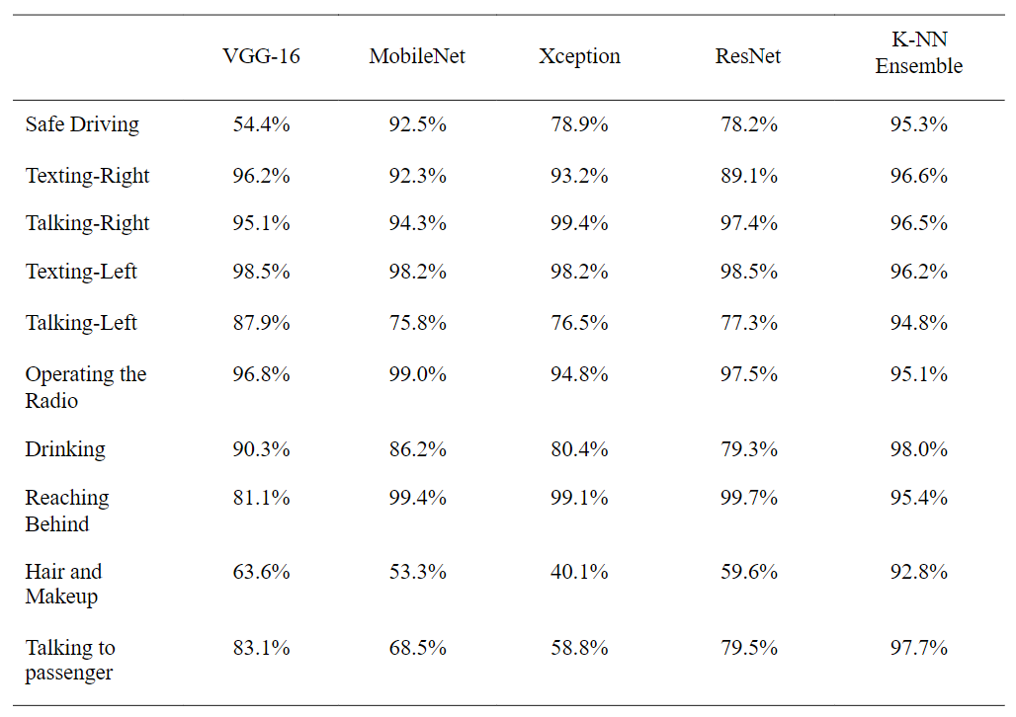
Performance Comparison
K-NN Ensemble Model
> 90% classification accuracy for each of the 10 classes
MobileNet
The best stand-alone transfer learning model
Highest validation accuracy across most classes
99.4% validation accuracy for the ‘reaching behind’ class
Table 2: Comparison of transfer learning models’ prediction accuracy per class.
Notes:
Based on Table 2, the most challenging posture to be classified is the ‘safe driving’ posture. This is due to lack of the previously mentioned temporal context. Apart from safe driving, the ‘hair and makeup’ posture has been mistaken as the ‘talking to passengers’ posture. That is because, in most cases, when drivers did their hair/makeup on the left side of their face, they needed to tilt their face slightly right (while looking at the frontal mirror). Thus, the network thought the person was talking to the passenger. Similarly, the ‘reaching behind’ posture has been mistaken as either ‘talking to passengers’ or ‘drinking’ posture. That makes sense as people tend to naturally look towards the camera while reaching behind. As for the drinking confusion, it is due to right-arm movement from the steering wheel to the back seat. A still image in the middle of that move could be easily mistaken for a drinking posture.

Slide 10
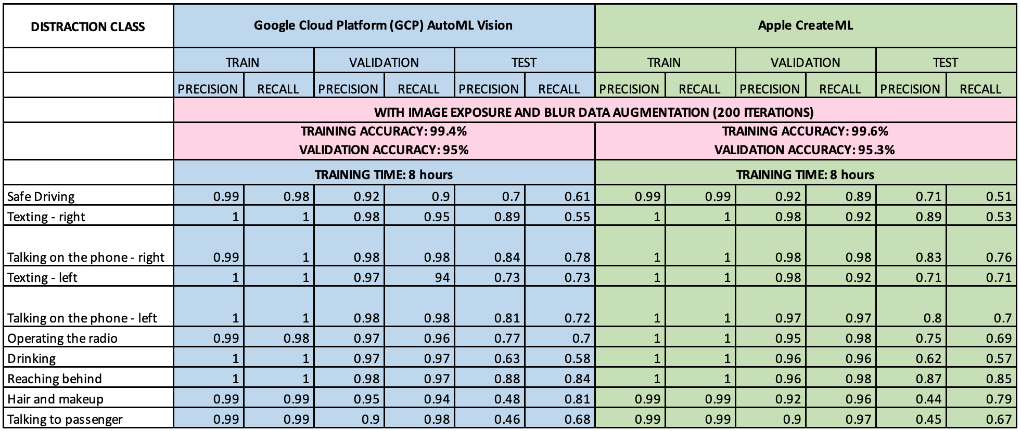
AutoML Model Performance Summary
Notes:
Deep neural network models were also created using AutoML platforms for computer vision of Google Cloud Platform and Apple’s Core ML. Training times turned out to be similar on both AutoML platforms, using the same dataset and many variations of the configurable parameters that are available on both platforms. Optimal classification performance was achieved at 200 iterations with augmented data for different image exposure and blur levels. This model that took approximately 8 hours to train was nearly perfect during training at classifying each of the distracted driver behavior that were defined in the training dataset.
But despite the exceptional classification training performance, overfitting was still evident as predictive performance noticeably dropped as these models were presented with another set of labeled images during validation, and even further dropped when presented with unseen holdout or test data.

Slide 11
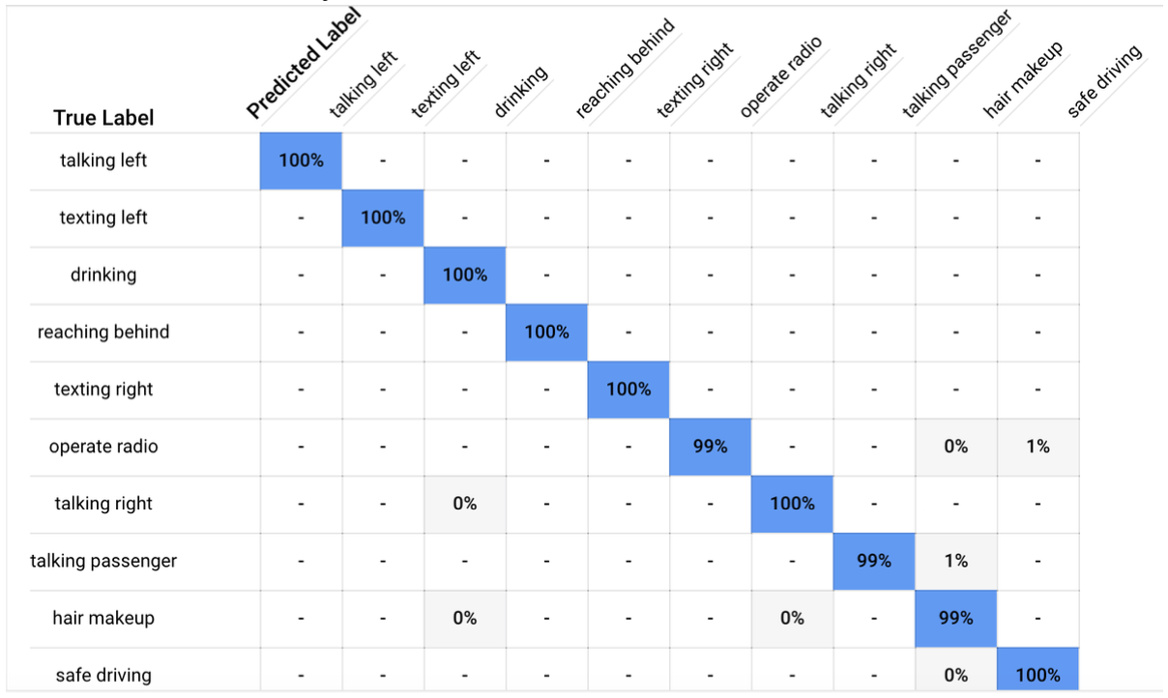
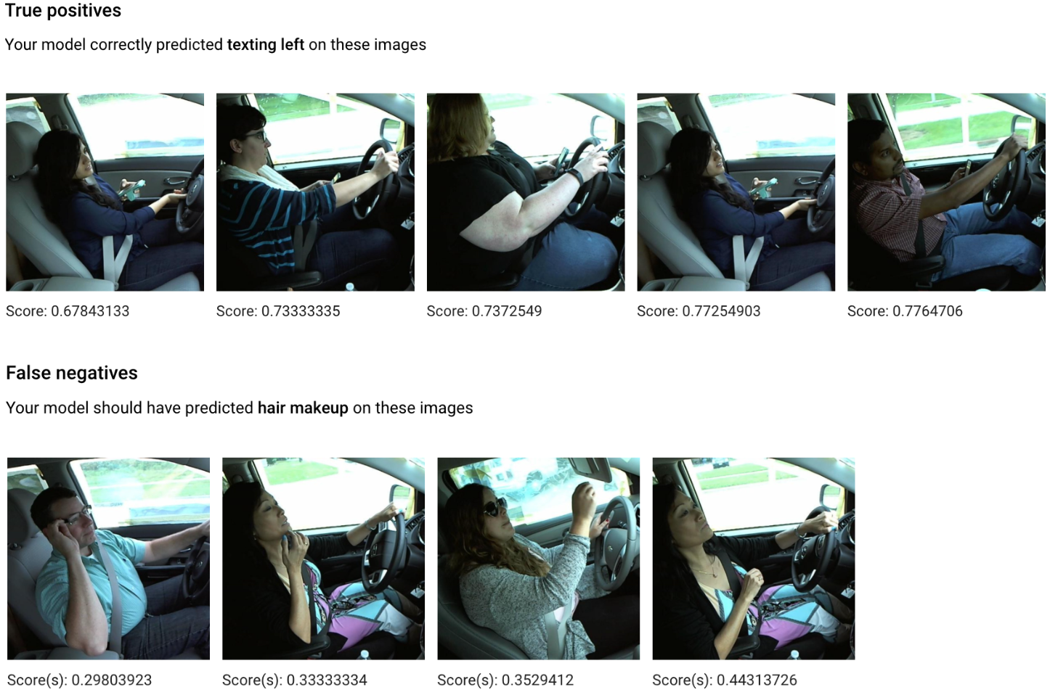
AutoML Model Performance Summary
Notes:
Looking further at the classification results, the AutoML models appeared to have put a focus on an object held by the driver. The confusion matrix shows the models was able to learn behaviors like talking and texting or drinking that involves a phone or a cup/mug. The models struggled a little bit on drivers operating a radio or talking to a passenger, or even safe driving positions where the hands were not holding on to anything other than the steering wheel. This set of sample inferences is another proof of the model’s higher confidence in predicting distracted behaviors with an object, and very low confidence with the ones with no object. Sample inferences show high confidence in detecting for driver texting while driving, but show very low confidence in determining if the driver is fixing hair or makeup.

Slide 12
DDBC Solution Prototypes
Notes:
The DDBC model that we developed can be packaged and deployed for practical use on many different platforms and deployment architectures. Through an Xcode project written in Swift language, we were able to develop an IOS app that was also shown at the beginning of this presentation that use the DDBC ML model to detect distracted driver behavior. We also developed a prototype of a python project that uses a tensorflow version of the DDBC model that provide inference for distracted driver behavior from an uploaded image or can be even an image taken from a camera. This model can be deployed in Android, linux, or windows-based devices.

Slide 13
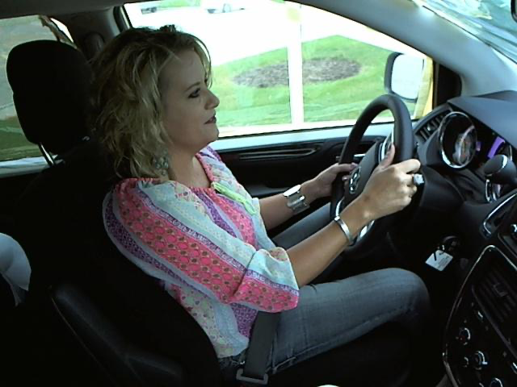
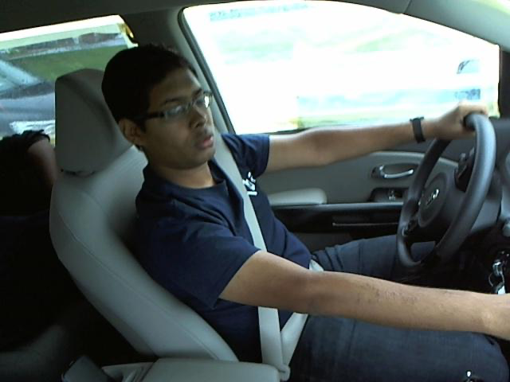
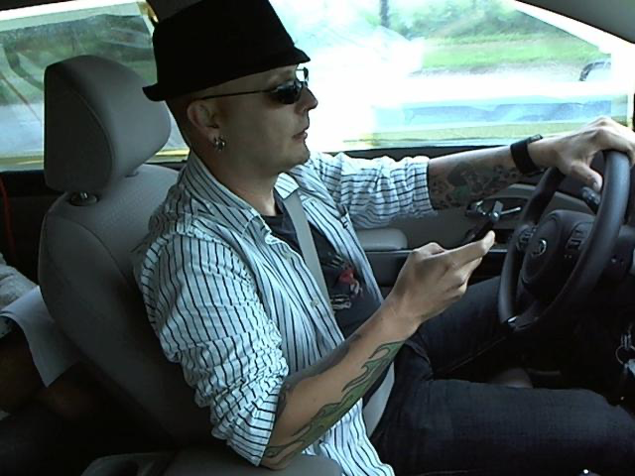
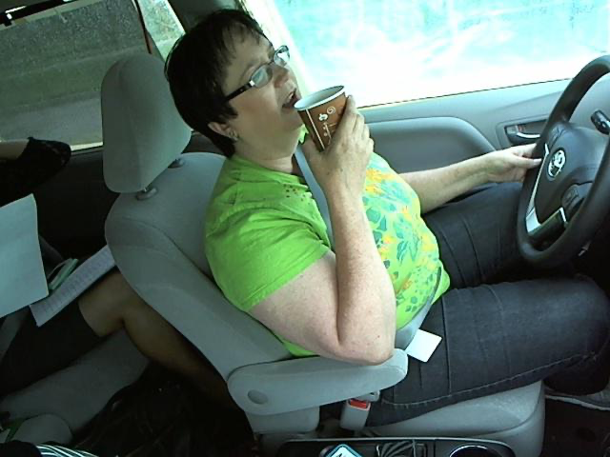
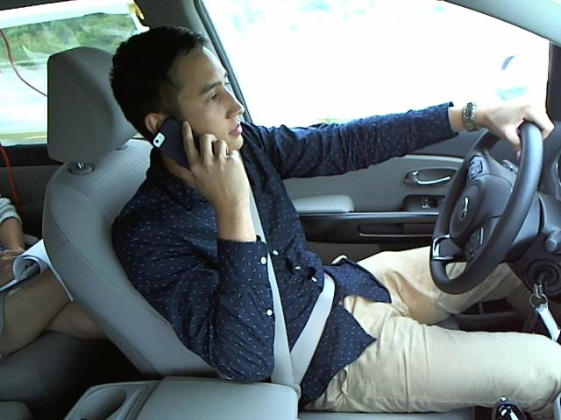
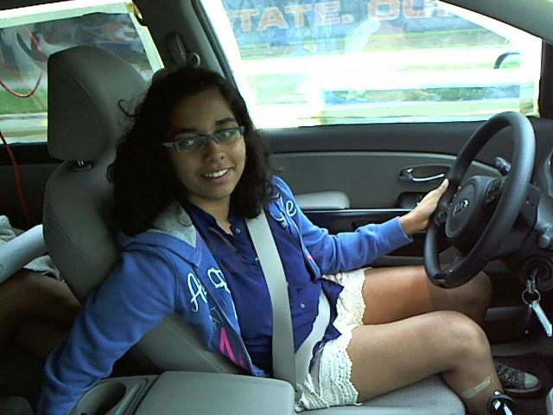
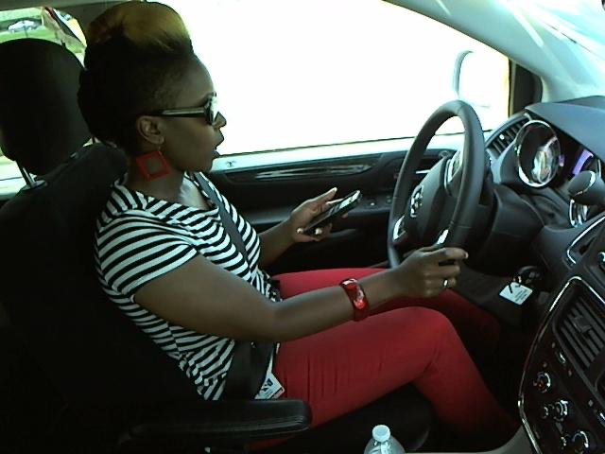
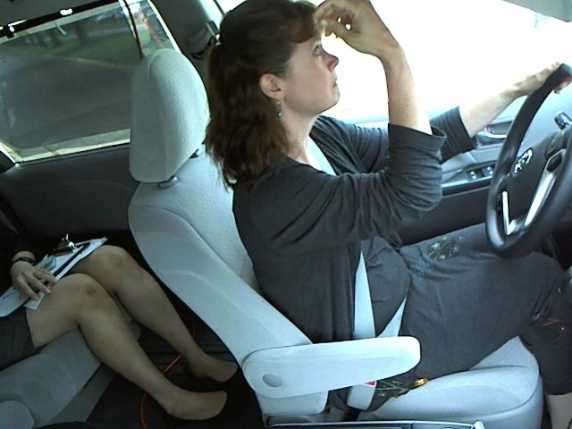
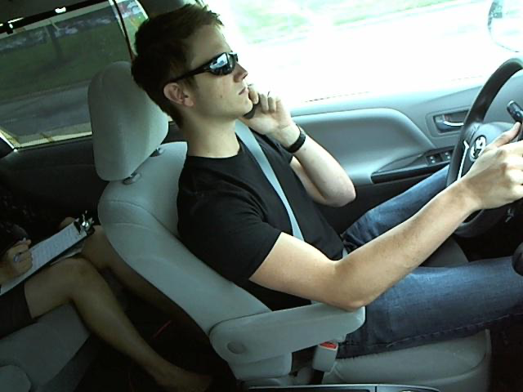
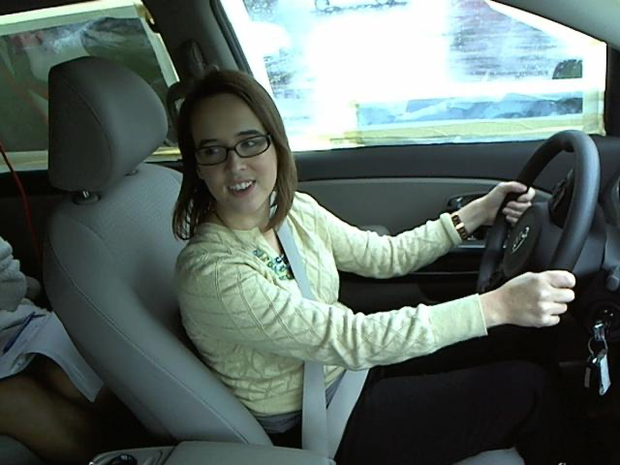
Inferences on New/Unseen Data
CLASS | Google Cloud Platform (GCP) AutoML Vision | Apple CreateML |  | CLASS | Google Cloud Platform (GCP) AutoML Vision | Apple CreateML
 | Texting - left (0.63) | Texting - left (0.88) |  |  | Operating the radio (0.74) | Operating the radio (0.85)
 | Texting - right (0.72) | Texting - right (0.99) |  |  | Drinking (0.30) | Drinking (0.92)
 | Talking on the phone - right (0.81) | Talking on the phone - right (0.99) |  |  | Reaching behind (0.73) | Talking to passenger (0.70)
 | Texting - left (0.85) | Safe driving (0.79) |  |  | Hair and makeup (0.77) | Hair and makeup (0.98)
 | Talking on the phone - left (0.83) | Talking on the phone - left (0.99) |  |  | Operating the radio (0.31) | Operating the radio (0.51)
* Green means correct classification, red means incorrect classification
Notes:
Overall on new data, the CreateML model classified for driver behaviors with higher confidence than the Google AutoML model. But the Google AutoML turned out to be the better model as it was able to consistently classify for more driver behavior classes than CreateML: 8 out of 10 classes vs 6 out of 10 classes.

Slide 14
Predictive Risks of DDBC
CLASS | PREDICTION | RISK
 | Safe driving (0.79) | Prediction as driving safely even if the driver is not False sense of security Safe driver record despite behavior violations
 | Texting - left (0.88) | Prediction of distracted driver even if the driver is in safe driving position Annoying and irritating incorrect distracted behavior alerts Unjustifiable unfavorable driving record
Notes:
Correctly classifying for more distracting behaviors is extremely important as it reflects on the reliability of DDBC to not miss these distracted behaviors if the driver is really on to something distractive. It will be a safety risk if DDBC recognizes safe driving even if the driver is texting. On the flip side, it can be annoying (and unfairly destructive of driver’ records) as well if DDBC keeps flagging for distracted driving even if the driver is very true to its duty of practicing safe driving.

Slide 15
Recommendations for future study
Our project provided a baseline performance and accuracy to benchmark against for future research.
Future recommendations include:
Data augmentation using color shifting and rotation of images for improved accuracy and to prevent overfitting
A better methodology to improve detection of face, hands, and skin
Training using a more powerful computing platform
Interfacing with Amazon assistant Alexa and all the Internet of Things (IoT) devices that Alexa interfaces with such as the Amazon Echo’s suite of personal assistant products.
Notes:
Despite the favorable results achieved by this version of DDBC, the machine learning model and this computer vision solution exposed some weaknesses which we wanted to explore in the future. We wanted to further explore on augmenting training data with color shifting and rotation of images to improve learning of driver positions under different shades of colors and angles, which can help improve prediction accuracy and mitigate overfitting.
We also consider exploring on other neural network configurations to improve detection of hand, face, and skin. We are also looking to perform training DDBC under a more powerful computing platform. And finally, we are planning to explore on interfacing with Amazon assistant Alexa and all of the IoT devices that Alexa interfaces with such as Amazon Echo’s suite of personal assistant products.

Slide 16
Questions?

